Slide 1

Firewall evasion
Bypassing firewalls using vpn
Sean Cummings, James Finn, Madina Martazanova, Heba Subeh

Slide 2
Firewall-VPN Lab: Bypassing Firewalls using VPN
Objective
Use IP tunneling to circumvent a firewall
Difficulty
Medium
Overview
3 tasks
VM setup
Setup firewall
Bypassing firewall using VPN
Tasks are consecutive
6 overall steps

Slide 3
Introduction
Terminology
Firewall:
- A firewall is a network security device that monitors incoming and outgoing network traffic and decides whether to allow or block specific traffic based on a defined set of security rules.
VPN:
- A virtual private network (VPN) is a network that is constructed using public wires usually the Internet to connect remote users or regional offices to a company's private, internal network.

Slide 4
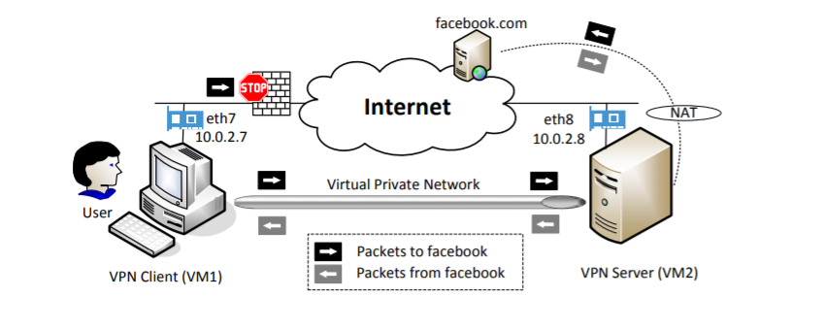
Introduction
- Two SEED Ubuntu 16.04 VMs running on same host machine

Slide 5
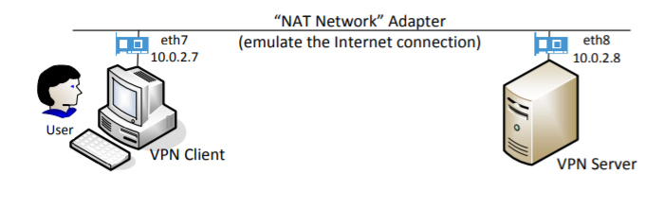
Task 1: vm setup
Notes:
We need 2 machines, one inside the firewall and one outside the firewall.
Both VM's are supposed to be connected to the internet through routers.
We emulate the internet connection using the NAT network adapter.

Slide 6
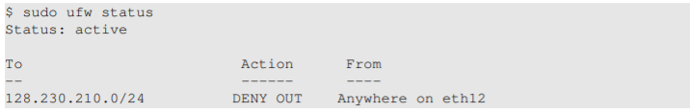
Task 2: Firewall setup
Need to ‘self-impose’ firewall on VM1
Functionally, works as a true firewall
Must do this after setting routing rules
Blocking www.brockport.edu - 146.20.54.0/24
ufw
Notes:
The goal here is to set up a firewall on VM1 to block the access of the target website. We used a fixed IP address for the target website to make sure it would be completely blocked.
We can't set the firewall rule before the routing because we need to make sure the firewall won't block the packets from getting to the virtual interface used by the VPN. We use the uncomplicated firewall program to do this.

Slide 7
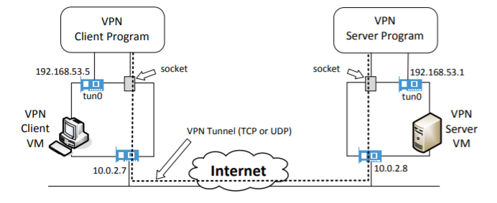
Task 3: bypassing the firewall

Slide 8
Task 3: bypassing the firewall
Overview
VM1 packets routed through VPN tunnel and arrive at VM2
VM2 routes packets to final (previously blocked) destination
Reply packets go to VM2 which redirects them through VPN tunnel to reach VM1

Slide 9

Task 3: Bypassing the firewall
Start server program
Assign IP address to tun0 interface and activate
Enable IP forwarding
Notes:
First command blocks while it waits for connections, need to find another window to run second command
Enable ip forwading so it behaves like a gateway

Slide 10

Task 3: Bypassing the firewall
Run VPN client on Client VM
Assign IP address 192.168.53.5 to tun0 interface
Notes:
After these, tunnel is established

Slide 11
Task 3: Bypassing the Firewall
Use route command to add routing entry
Notes:
In example we route 10.20.30.0/24 packets to eth0 interface

Slide 12
Task 3: Bypassing the Firewall
Usually, NAT replaces destination IP address with IP address of original packet and gives it back to whoever owns the IP address
Before NAT sends out packet needs to know MAC address of machine who owns the IP address of original packet, sends ARP request
Our private network is virtual, and this address belongs to tun0, so this address wont receive ARP request
Nat drops packet
Need to configure NAT as gateway, but we can’t do this in VirtualBox

Slide 13
Task 3: Bypassing the Firewall
Solution 1:
“fool” NAT to believe MAC address of 192.168.53.5 is the VPN Server VM’s MAC address
Solution 2 (preferred):
Create another NAT on the Server VM
Notes:
Soln 1: packet delivered to VPN Server by NAT.
Use ARP cache poisoning on the NAT: telling NAT before hand about the MAC address
Soln 2:
so all packets coming out of the Server VM will have this VM’s IP address as their source IP. To reach the Internet, these packets will go through another NAT, which is provided by VirtualBox, but since the source IP is the Server VM, this second NAT will have no problem relaying back the returned packets from the Internet to the Server VM

Slide 14

Task 3: Bypassing the firewall
Enable NAT on Server VM
Notes:
Packet sent to VPN server first because?

Slide 15
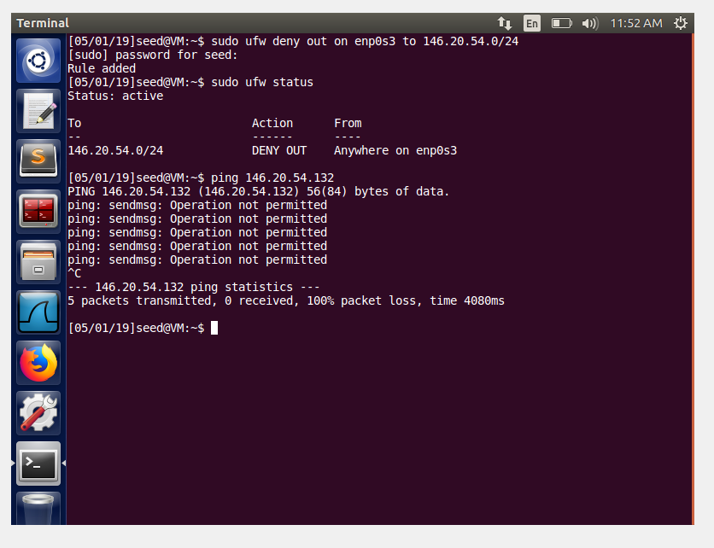
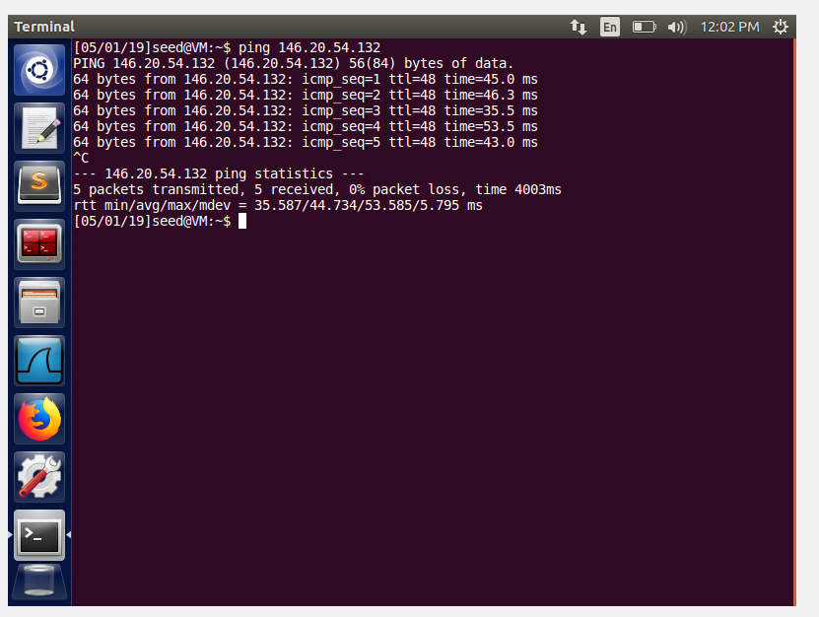
results

Slide 16

Thank You!

